Slide 1

CS302 Design and Analysis of Algorithms
Muhammad sohail afzal

Slide 2
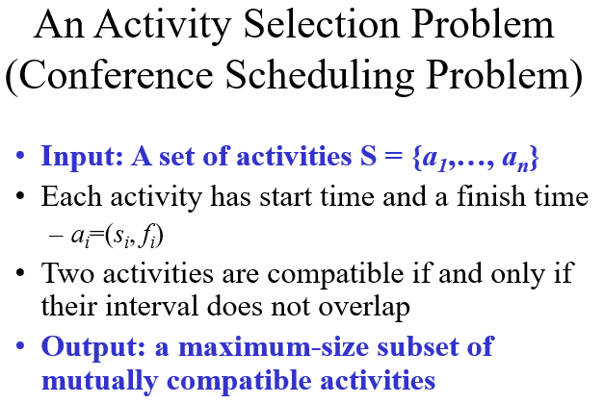
Activity Selection problem: Greedy Approach

Slide 3
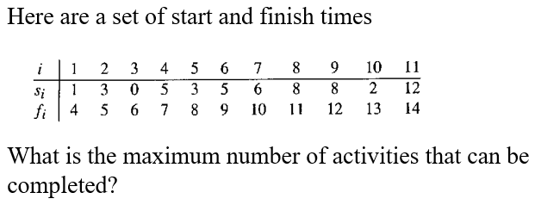
Activity Selection problem: Greedy Approach

Slide 4
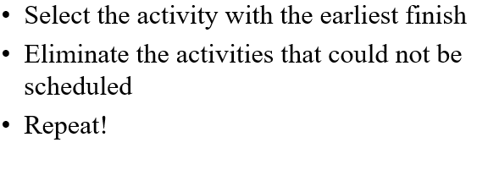
Activity Selection problem: Greedy Approach
Greedy approach is :

Slide 5
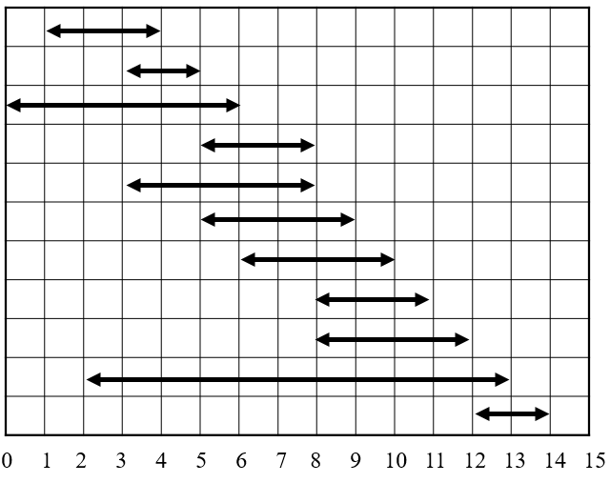
Activity Selection problem: Greedy Approach
All activities :

Slide 6
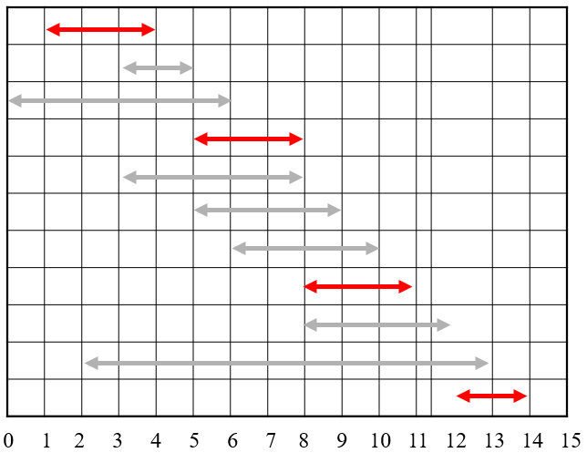
Activity Selection problem: Greedy Approach
Selected activities:

Slide 7
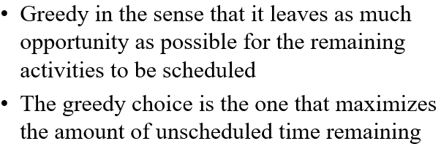
Activity Selection problem: Greedy Approach
Greedy approach is good for activity selection problem.

Slide 8
Coin change Problem: Failure of Greedy Approach
Greedy approach does not always give optimal result :
Suppose you have 3 coins :
A coin of 7
A coin of 1
A coin of 11
You want to make 14 using minimum number of coins. This is the problem.

Slide 9
Coin change Problem: Failure of Greedy Approach
Greedy approach will be to select the highest valued coin and then substracting 14 from highest valued coin and based on that value, again selecting highest value coin.
For example:
You want to make 14 from coin of 1, 7 and 11. You selected highest valued coin which is 11. Now 14-11 = 3. So keeping in mind 3, highest valued coin would be 1. So you will select 3 coins of 1.
11+1+1+1 = 14 (4 coins)
Now greedy approach fails here because by using just two coins of 7, I can make 14
7+7 = 14 (2 coins)
Dynamic programming approach is best for coin change that you will solve in assignment 3.

Slide 10
Knapsack Problem : Greedy approach
Greedy approach is also good for fractional knapsack problem but not for 0/1 knapsack.
In knapsack problem, you have a bag (knapsack) and you want to fill it with the combination of items that will give highest value in the given capacity of bag W.
It is of two types :
Fractional knapsack
In which you can take fraction of item if you want
0/1 knapsack
In which you can only take complete item or leave it but you cannot take fraction of it

Slide 11
Knapsack Problem : Greedy approach
Suppose “i” item has value “v(i)” and weight “w(i)”. Capacity of knapsack (bag) is W. Then greedy approach would be :
Sort in decreasing order of value/weight i-e v(i)/w(i)
Now start selecting items till you fill the bag and capacity does not exceed W.
In fractional knapsack, you utilize complete capacity W because you can take fraction of items but in 0/1 knapsack, you may or may not.

Slide 12
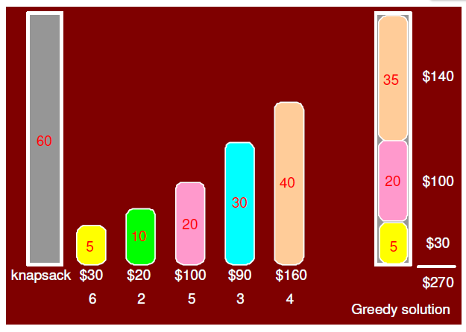
Greedy approach for Fractional Knapsack
Greedy/optimal solution to fractional knapsack is :

Slide 13
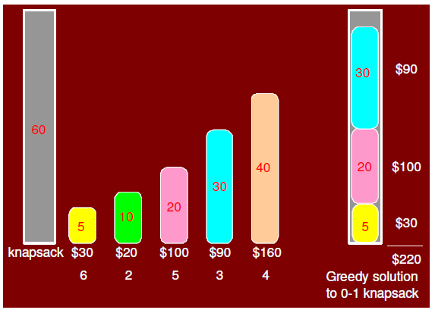
Greedy approach for 0/1 Knapsack
Greedy solution to 0/1 knapsack :

Slide 14
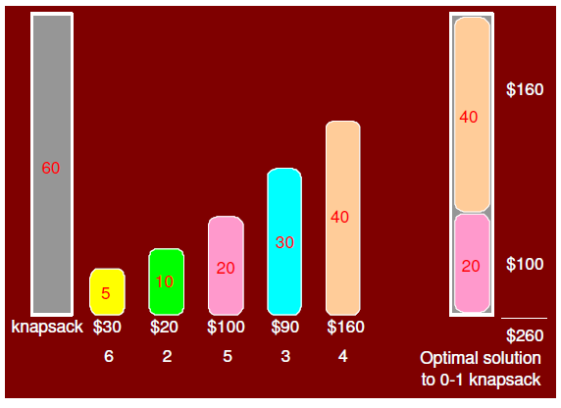
Non-Greedy approach for 0/1 Knapsack
Optimal/non-greedy solution to 0/1 knapsack :

Slide 15
Greedy approach for Knapsack
You can notice in first diagram that greedy approach on fractional knapsack gave optimal result because it gave maximum possible value of 270$ in the given capacity.
But 0/1 knapsack failed using greedy approach (in second diagram) because it gave output of just 220$ while 260$ could still be possible (in last diagram) by randomly choosing 20kg and 40kg weight.
So greedy approach fails on 0/1 knapsack for which dynamic programming is more better approach.

